Slide 1
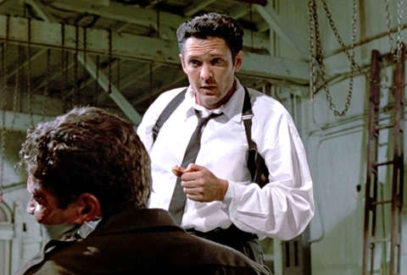
Torture is punishment Evidence that punitive motives eclipse informational motives among supporters of "enhanced interrogation" torture

Slide 2
Based on a manuscript by Hansen & Callaghan (undergoing revisions after reviewer feedback)
Ian Hansen, York College
Bennett Callaghan, Yale University

Slide 3
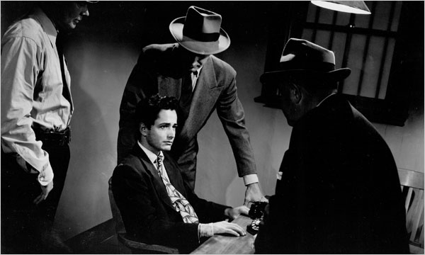
Some background on interrogation and torture
Government forces (police, military, CIA, etc) have interrogation programs
The supposed purpose of interrogation is to obtain true information (either accurate intelligence or a true confession to a crime)
The infliction of excruciating physical and psychological suffering on detained persons is often employed during such interrogations
The government legally authorizes as “not torture” some of these horrific inflictions of suffering, and legally forbids (but readily forgives) others

Slide 4
Some background on interrogation and torture
Government forces (police, military, CIA, etc) have interrogation programs
The supposed purpose of interrogation is to obtain true information (either accurate intelligence or a true confession to a crime)
The infliction of excruciating physical and psychological suffering on detained persons is often employed during such interrogations
The government legally authorizes as “not torture” some of these horrific inflictions of suffering, and legally forbids (but readily forgives) others

Slide 5
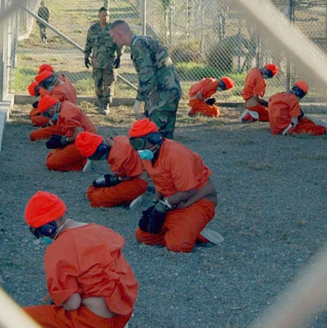
Some background on interrogation and torture
Government forces (police, military, CIA, etc) have interrogation programs
The supposed purpose of interrogation is to obtain true information (either accurate intelligence or a true confession to a crime)
The infliction of excruciating physical and psychological suffering on detained persons is often employed during such interrogations
The government legally authorizes as “not torture” some of these horrific inflictions of suffering, and legally forbids (but readily forgives) others

Slide 6
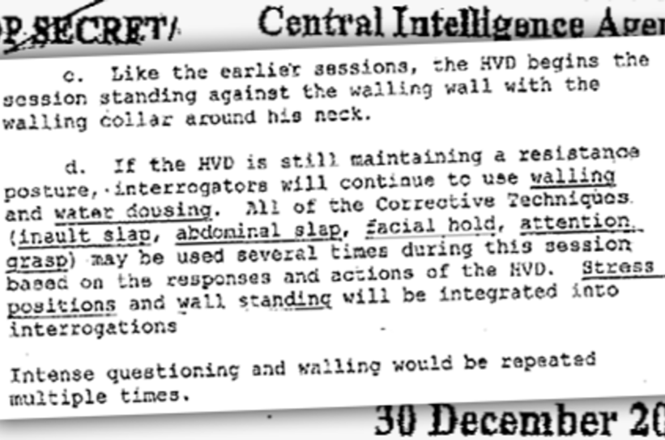
Some background on interrogation and torture
Government forces (police, military, CIA, etc) have interrogation programs
The supposed purpose of interrogation is to obtain true information (either accurate intelligence or a true confession to a crime)
The infliction of excruciating physical and psychological suffering on detained persons is often employed during such interrogations
Governments often legally authorize as “Standard Operating Procedure” some of these horrific inflictions of suffering, and legally forbid (but often readily forgive) others

Slide 7
Some background on interrogation and torture
Government forces (police, military, CIA, etc) have interrogation programs
The supposed purpose of interrogation is to obtain true information (either accurate intelligence or a true confession to a crime)
The infliction of excruciating physical and psychological suffering on detained persons is often employed during such interrogations
Governments often legally authorize as “Standard Operating Procedure” some of these horrific inflictions of suffering, and legally forbid (but often readily forgive) others

Slide 8
In reality, torture is a truth-killer
5 ) “Infliction of suffering”—let’s just call it torture—is a lousy method of obtaining true information, inferior to almost any other method of fact-gathering.
6) It is, however, a sometimes effective way of obtaining forced claims of fact for propaganda purposes or to make interrogators feel better about their hunches.
6) It is also a human rights abuse and crime against humanity, morally repulsive by any working sense of “Do unto others” morality.
See also:
Costanzo & Gerrity (2009)
Ghosh (2009)
O’Mara (2015)

Slide 9
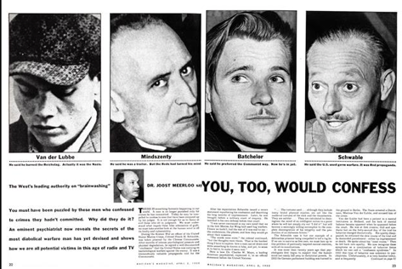
In reality, torture is a truth-killer
5 ) “Infliction of suffering”—let’s just call it torture—is a lousy method of obtaining true information, inferior to almost any other method of fact-gathering.
6) It is, however, a sometimes effective way of obtaining forced claims of fact for propaganda purposes, to avoid fair trials, or to make interrogators feel better about their hunches.
7) It is also a human rights abuse and crime against humanity, morally repulsive by any working sense of “Do unto others” morality.

Slide 10
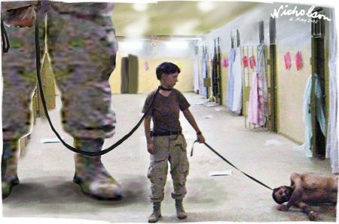
In reality, torture is a truth-killer
5 ) “Infliction of suffering”—let’s just call it torture—is a lousy method of obtaining true information, inferior to almost any other method of fact-gathering.
6) It is, however, a sometimes effective way of obtaining forced claims of fact for propaganda purposes or to make interrogators feel better about their hunches.
7) It is also a human rights abuse and crime against humanity, morally repulsive by any “Do unto others” moral system.

Slide 11
In reality, torture is a truth-killer
5 ) “Infliction of suffering”—let’s just call it torture—is a lousy method of obtaining true information, inferior to almost any other method of fact-gathering.
6) It is, however, a sometimes effective way of obtaining forced claims of fact for propaganda purposes, to avoid fair trials, or to make interrogators feel better about their hunches.
7) It is also a human rights abuse and crime against humanity, morally repulsive by any “Do unto others” moral system.

Slide 12
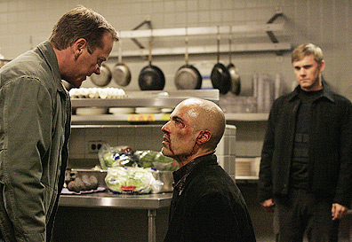
But people think torture is a truth-enhancer
8) Many ordinary people genuinely seem to think that torture is effective for obtaining true information, especially if the torture is directed towards someone else they consider an evil-doer.
9) Part of this intuition seems related to a tendency to imagine that because a person seems worthy of torturous punishment, justly punishing them with torture will lead to other good things, like them revealing true information.

Slide 13
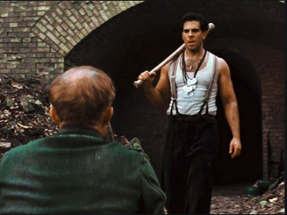
But people think torture is a truth-enhancer
8) Many ordinary people genuinely seem to think that torture is effective for obtaining true information, especially if the torture is directed towards someone else they consider an evil-doer.
9) Part of this intuition seems related to a tendency to imagine that because a person seems worthy of torturous punishment, justly punishing them with torture will lead to other good things, like them revealing true information.

Slide 14
But people think torture is a truth-enhancer
8) Many ordinary people genuinely seem to think that torture is effective for obtaining true information, especially if the torture is directed towards someone else they consider an evil-doer.
9) Part of this intuition seems related to a tendency to imagine that because a person seems worthy of torturous punishment, justly punishing them with torture will lead to other good things, like them revealing true information.

Slide 15
So a “rough justice brings good things” mentality may explain this intuition
10) Research shows that people tend to mix up punitive goals with goals to achieve other good things (like lower crime, find true information, save lives, etc)
11) but in fact punishment only guarantees the suffering of the punished, not necessarily the outcomes it’s supposedly designed to achieve.
See Carlsmith & Sood (2009)
Ellsworth & Ross (1983)

Slide 16
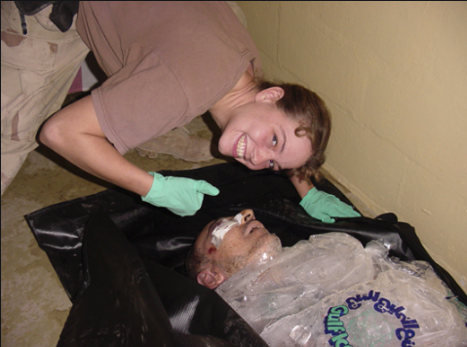
So a “rough justice brings good things” mentality may explain this intuition
10) much research shows that people tend to mix up punitive goals with goals to achieve other good things (like lower crime, find true information, save lives, etc)
11) But actually punishment only guarantees the suffering of the punished, not necessarily the outcomes it’s supposedly designed to achieve.

Slide 17
So a “rough justice brings good things” mentality may explain this intuition
10) Research shows that people tend to mix up punitive goals with goals to achieve other good things (like lower crime, find true information, save lives, etc)
11) But actually punishment only guarantees the suffering of the punished, not necessarily the outcomes it’s supposedly designed to achieve.

Slide 18
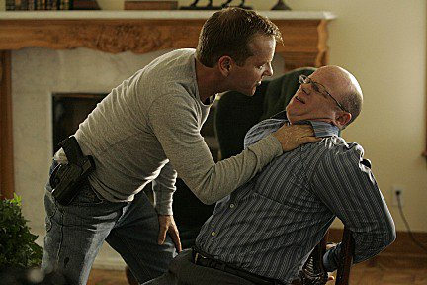
In fact, the mixed motivations might partially explain why torture is so notorious for obtaining false and redundant information.
I want the life-saving, love-serving truth to flower from him in its beautiful fullness
I want to severely punish him with torture

Slide 19
Some people, though, openly admit that information is a minor concern
“Would I approve waterboarding? You bet your ass I would. In a heartbeat. I would approve more than that. It works…and if it doesn’t work, they deserve it anyway for what they do to us”.
I don’t give a good [expletive] what you know or don’t know, but I’m going to torture you anyway regardless. Not to get information. It’s amusing to me to torture a cop.”
From Quentin Tarantino’s Reservoir Dogs

Slide 20
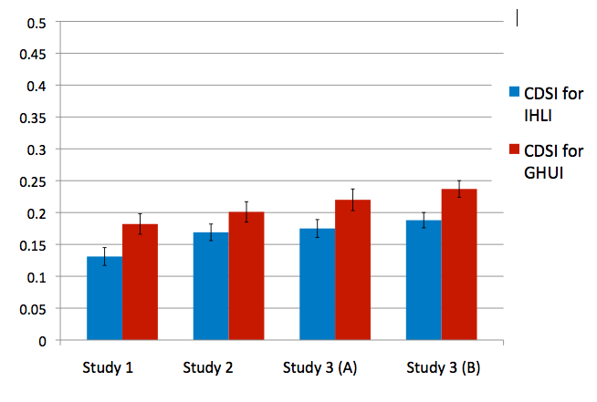
Overview of the studies
Three studies, one with two samples receiving largely the same measures of interest.
The first two studies present participants with some variation on two hypothetical scenarios imagining detainees captured by pro-US Coalition forces in Afghanistan
One scenario involved a detainee who probably did bad, killing, things in his past but was highly unlikely to be concealing useful information
Another involved a detainee who had probably done no bad things in his past, but was highly likely to be concealing useful information.
We adapted these scenarios from variations used in a study by Carlsmith & Sood (2009), and also Callaghan & Hansen (2016).

Slide 21
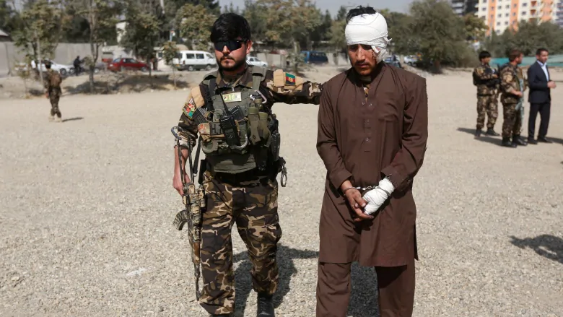
Overview of the studies
Three studies, one with two samples receiving largely the same measures of interest.
The first two studies present participants with some variation on two hypothetical scenarios imagining detainees captured by pro-US Coalition forces in Afghanistan
One scenario involved a detainee who probably did bad, killing, things in his past but was highly unlikely to be concealing useful information
Another involved a detainee who had probably done no bad things in his past, but was highly likely to be concealing useful information.
We adapted these scenarios from variations used in a study by Carlsmith & Sood (2009), and also Callaghan & Hansen (2016).

Slide 22
Overview of the studies
Three studies, one with two samples receiving largely the same measures of interest.
The first two studies present participants with some variation on two hypothetical scenarios imagining detainees captured by pro-US Coalition forces in Afghanistan
One scenario involved a detainee who probably did bad, killing, things in his past but was highly unlikely to be concealing useful information
Another involved a detainee who had probably done no bad things in his past, but was highly likely to be concealing useful information.
We adapted these scenarios from variations used in a study by Carlsmith & Sood (2009), and also Callaghan & Hansen (2016).

Slide 23
Overview of the studies
Three studies, one with two samples receiving largely the same measures of interest.
The first two studies present participants with some variation on two hypothetical scenarios imagining detainees captured by pro-US Coalition forces in Afghanistan
One scenario involved a detainee who probably did bad, killing, things in his past but was highly unlikely to be concealing useful information
Another involved a detainee who had probably done no bad things in his past, but was highly likely to be concealing useful information.
We adapted these scenarios from variations used in a study by Carlsmith & Sood (2009), and also Callaghan & Hansen (2016).

Slide 24
Overview of the studies
Three studies, one with two samples receiving largely the same measures of interest.
The first two studies present participants with some variation on two hypothetical scenarios imagining detainees captured by pro-US Coalition forces in Afghanistan
One scenario involved a detainee who probably did bad, killing, things in his past but was highly unlikely to be concealing useful information
Another involved a detainee who had probably done no bad things in his past, but was highly likely to be concealing useful information.
We adapted these scenarios from variations used in a study by Carlsmith & Sood (2009), and also Callaghan & Hansen (2016).

Slide 25
Overview of the studies
Three studies, one with two samples receiving largely the same measures of interest.
The first two studies present participants with some variation on two hypothetical scenarios imagining detainees captured by pro-US Coalition forces in Afghanistan
One scenario involved a detainee who probably did bad, killing, things in his past but was highly unlikely to be concealing useful information
Another involved a detainee who had probably done no bad things in his past, but was highly likely to be concealing useful information.
We adapted these scenarios from variations used in a study by Carlsmith & Sood (2009), and also Callaghan & Hansen (2016).

Slide 26
Participants imagine…
“Imagine you are part of a counterterrorism team in Afghanistan. Your team is responsible for interrogating two detainees, Mahmud Malik and Ahmed Farid. Both are Afghans in their 20s who had been previously detained by U.S. and coalition forces in 2009 on suspicion of terrorist activities.”

Slide 27
Malik (IHLI detainee)
Malik makes his living by tending a small herd of goats. Previous investigators ultimately found no evidence that he ever engaged in or supported violent or insurgent activities in any way. Nevertheless, he is suspected to have overheard plans for attack on soldiers and civilians—plans that, understandably, he would be afraid to share. Malik claims to have no direct knowledge of the insurgents, their plans, their routes, or anything remotely useful to the Coalition Forces. He has stated this repeatedly, but his questioners feel that he almost certainly has some useful information. Based on the experience of thousands of prior interrogations, investigators say there is a 95% chance that Malik is actually withholding information that might prevent lethal attacks on soldiers or innocent civilians.
Malik appears not to be guilty of anything, but has a high chance of having information. [Innocent Highly Likely to have Information (IHLI)]

Slide 28
Farid (GHUI detainee)
Farid’s situation is different. Farid had been a member of an extremist Islamist group since his early teen years, had supported the Taliban when they were in power, and had been an active member of the insurgency from 2002 to 2005—during which time he set numerous roadside bombs, attacked civilians who cooperated with Coalition forces, and participated in ambushes that killed four U.S. Marines. Farid has since withdrawn from the insurgency and so has hadlittle or no contact with enemies of the Coalition forces. He had been captured from his poppy farm, which was in close proximity to a camp of Taliban insurgents.
Like Malik, Farid claims to have no direct knowledge of the insurgents, their plans, their routes, or anything remotely useful to the Coalition Forces. His questioners also believe it is highly unlikely that he has any useful information. Based on the experience of thousands of prior interrogations, investigators say there is practically no chance (0%) that Farid is withholding information that might prevent lethal attacks on soldiers or innocent civilians.
Farid appears to be guilty of killing soldiers and civilians, but there is almost no chance that he has useful information.

Slide 29
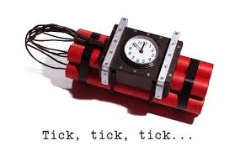
Why not have participants consider a blend of Malik and Farid?
Meaning “someone who probably did bad things and was hiding information”.
Including this scenario would have just given us responses that would be difficult to interpret (if participants support torture in such a scenario is it because they want info or to punish the evildoer?)
With our two scenarios, participants had to consider whether they were more supportive of torturing the informed-but-innocent detainee or more supportive of torturing the guilty-but-uninformed detainee.
Their choices offered direct insight into whether they considered torture more appropriate as a form of punishment or as a form of information-gathering.

Slide 30
Why not have participants consider a blend of Malik and Farid?
Meaning “someone who probably did bad things _and_ was hiding information”.
Including this scenario would have just given us responses that would be difficult to interpret (if participants support torture in such a scenario is it because they want info or to punish the evildoer?)
With our two scenarios, participants had to consider whether they were more supportive of torturing the informed-but-innocent detainee or more supportive of torturing the guilty-but-uninformed detainee.
Their choices offered direct insight into whether they considered torture more appropriate as a form of punishment or as a form of information-gathering.

Slide 31
Why not have participants consider a blend of Malik and Farid?
Meaning “someone who probably did bad things _and_ was hiding information”.
Including this scenario would have just given us responses that would be difficult to interpret (if participants support torture in such a scenario is it because they want info or to punish the evildoer?)
With our two scenarios, participants had to consider whether they were more supportive of torturing the informed-but-innocent detainee or more supportive of torturing the guilty-but-uninformed detainee.
Their choices offered direct insight into whether they considered torture more appropriate as a form of punishment or as a form of information-gathering.

Slide 32
Why not have participants consider a blend of Malik and Farid?
Meaning “someone who probably did bad things _and_ was hiding information”.
Including this scenario would have just given us responses that would be difficult to interpret (if participants support torture in such a scenario is it because they want info or to punish the evildoer?)
With our two scenarios, participants had to consider whether they were more supportive of torturing the informed-but-innocent detainee or more supportive of torturing the guilty-but-uninformed detainee.
Their choices offered direct insight into whether they considered torture more appropriate as a form of punishment or as a form of information-gathering.

Slide 33
Why not have participants consider a blend of Malik and Farid?
Meaning “someone who probably did bad things and was hiding information”.
Including this scenario would have just given us responses that would be difficult to interpret (if participants support torture in such a scenario is it because they want info or to punish the evildoer?)
With our two scenarios, participants had to consider whether they were more supportive of torturing the informed-but-innocent detainee or more supportive of torturing the guilty-but-uninformed detainee.
Their choices offered direct insight into whether they considered torture more appropriate as a form of punishment or as a form of information-gathering.

Slide 34
Dependent measures (I)
Information concern:“How important is it to use effective methods to obtain the truth about what [Malik/Farid] really knows or doesn’t know?”
Punitiveness: “How necessary is it to punish [Malik/Farid]?”
1 = totally [unimportant/unnecessary]
9 = totally [important/necessary]

Slide 35
Dependent measures (II)
Abstractly-Conceived Severe Interrogation (ACSI)
“What is the maximum degree of interrogation severity that is appropriate for Malik/Farid?”
1 = not at all beyond conversational (just asking questions)
9 = extremely severe (causing permanent physical and psychological scars, pushing to the limits of human endurance of suffering)

Slide 36
Dependent measures (III)
Concretely-Described Severe Interrogation (CDSI)
16 described torture methods
Participants could support some proportion of those techniques from 0% to 100%.

Slide 37
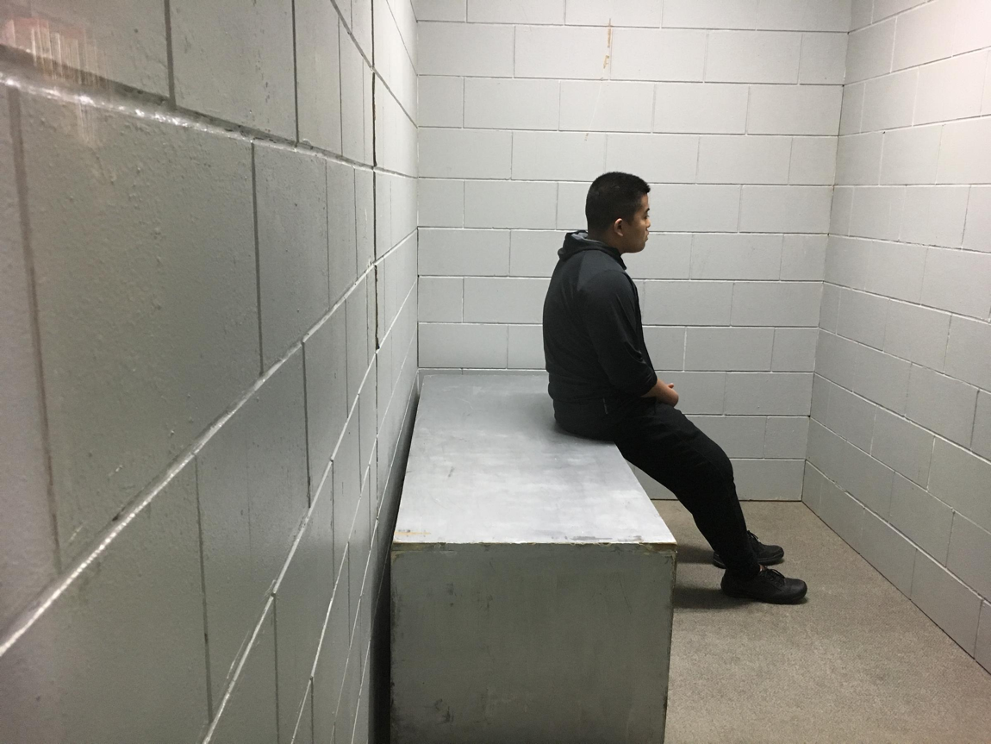
Concretely Described Severe Interrogation (CDSI) methods
Isolation as severe interrogation- e.g. removing the individual from all human contact to induce psychosis and regression.
Threats of harm (e.g. threatening mutilation) or death (e.g. threatening execution) as severe interrogation.
Leave- no-marks physical assault (e.g. slapping, shaking) as severe interrogation.
Stress positions as severe interrogation- e.g. forcing the individual to maintain stances that quickly become excruciatingly painful.
Sleep deprivation as severe interrogation- e.g. making the individual go so long without sleep that he or she experiences disorientation, psychosis or regression.
Exploitation of fears, phobias or psychopathology as severe interrogation-e.g. pauuting insects on someone known to have a fear of insects.

Slide 38
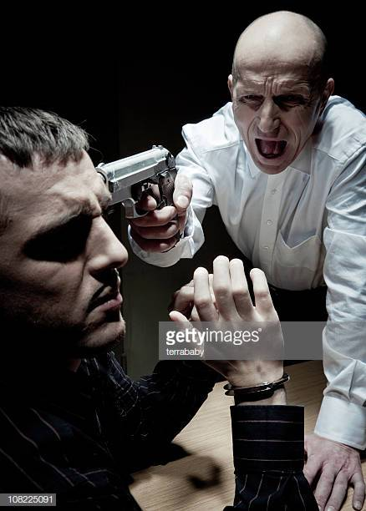
Concretely Described Severe Interrogation (CDSI) methods
Isolation as severe interrogation- e.g. removing the individual from all human contact to induce psychosis and regression.
Threats of harm (e.g. threatening mutilation) or death (e.g. threatening execution) as severe interrogation.
Leave- no-marks physical assault (e.g. slapping, shaking) as severe interrogation.
Stress positions as severe interrogation- e.g. forcing the individual to maintain stances that quickly become excruciatingly painful.
Sleep deprivation as severe interrogation- e.g. making the individual go so long without sleep that he or she experiences disorientation, psychosis or regression.
Exploitation of fears, phobias or psychopathology as severe interrogation-e.g. pauuting insects on someone known to have a fear of insects.

Slide 39
Concretely Described Severe Interrogation (CDSI) methods
Isolation as severe interrogation- e.g. removing the individual from all human contact to induce psychosis and regression.
Threats of harm (e.g. threatening mutilation) or death (e.g. threatening execution) as severe interrogation.
Leave-no-marks physical assault (e.g. slapping, shaking) as severe interrogation.
Stress positions as severe interrogation- e.g. forcing the individual to maintain stances that quickly become excruciatingly painful.
Sleep deprivation as severe interrogation- e.g. making the individual go so long without sleep that he or she experiences disorientation, psychosis or regression.
Exploitation of fears, phobias or psychopathology as severe interrogation-e.g. pauuting insects on someone known to have a fear of insects.

Slide 40
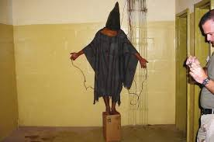
Concretely Described Severe Interrogation (CDSI) methods
Isolation as severe interrogation- e.g. removing the individual from all human contact to induce psychosis and regression.
Threats of harm (e.g. threatening mutilation) or death (e.g. threatening execution) as severe interrogation.
Leave- no-marks physical assault (e.g. slapping, shaking) as severe interrogation.
Stress positions as severe interrogation- e.g. forcing the individual to maintain stances that quickly become excruciatingly painful.
Sleep deprivation as severe interrogation- e.g. making the individual go so long without sleep that he or she experiences disorientation, psychosis or regression.
Exploitation of fears, phobias or psychopathology as severe interrogation-e.g. pauuting insects on someone known to have a fear of insects.

Slide 41
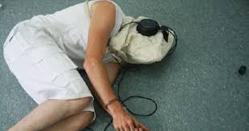
Concretely Described Severe Interrogation (CDSI) methods
Isolation as severe interrogation- e.g. removing the individual from all human contact to induce psychosis and regression.
Threats of harm (e.g. threatening mutilation) or death (e.g. threatening execution) as severe interrogation.
Leave- no-marks physical assault (e.g. slapping, shaking) as severe interrogation.
Stress positions as severe interrogation- e.g. forcing the individual to maintain stances that quickly become excruciatingly painful.
Sleep deprivation as severe interrogation- e.g. making the individual go so long without sleep that he or she experiences disorientation, psychosis or regression.
Exploitation of fears, phobias or psychopathology as severe interrogation-e.g. pauuting insects on someone known to have a fear of insects.

Slide 42
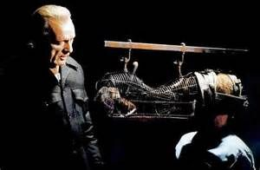
Concretely Described Severe Interrogation (CDSI) methods
Isolation as severe interrogation- e.g. removing the individual from all human contact to induce psychosis and regression.
Threats of harm (e.g. threatening mutilation) or death (e.g. threatening execution) as severe interrogation.
Leave- no-marks physical assault (e.g. slapping, shaking) as severe interrogation.
Stress positions as severe interrogation- e.g. forcing the individual to maintain stances that quickly become excruciatingly painful.
Sleep deprivation as severe interrogation- e.g. making the individual go so long without sleep that he or she experiences disorientation, psychosis or regression.
Exploitation of fears, phobias or psychopathology as severe interrogation-e.g. putting insects on someone known to have a fear of insects.

Slide 43
Concretely-Described Severe Interrogation (CDSI) methods
Threatening harm or death to family members of the individual as severe interrogation.
Cultural or religious humiliation as severe interrogation-i.e. deliberately making the individual endure things that might be commonplace in your own culture or religion but are deeply humiliating and psychologically agonizing in his/her culture.
Sensory deprivation or over- stimulation as severe interrogation-e.g. blocking or bombarding bodily senses to induce disorientation, psychosis and regression.
The use of psychotropic drugs or mind- altering substances (e.g. LSD) as severe interrogtion to induce disorientation, psychosis, or erasure of memory and identity.
Severe physical assault that leaves marks, bruises or lacerations, as severe interrogation.

Slide 44
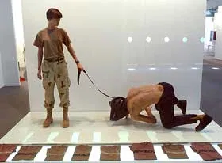
Concretely-Described Severe Interrogation (CDSI) methods
Threatening harm or death to family members of the individual as severe interrogation.
Cultural or religious humiliation as severe interrogation-i.e. deliberately making the individual endure things that might be commonplace in your own culture or religion but are deeply humiliating and psychologically agonizing in his/her culture.
Sensory deprivation or over- stimulation as severe interrogation-e.g. blocking or bombarding bodily senses to induce disorientation, psychosis and regression.
The use of psychotropic drugs or mind- altering substances (e.g. LSD) as severe interrogtion to induce disorientation, psychosis, or erasure of memory and identity.
Severe physical assault that leaves marks, bruises or lacerations, as severe interrogation.

Slide 45
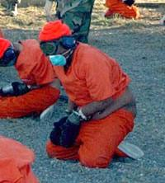
Concretely-Described Severe Interrogation (CDSI) methods
Threatening harm or death to family members of the individual as severe interrogation.
Cultural or religious humiliation as severe interrogation-i.e. deliberately making the individual endure things that might be commonplace in your own culture or religion but are deeply humiliating and psychologically agonizing in his/her culture.
Sensory deprivation or over- stimulation as severe interrogation-e.g. blocking or bombarding bodily senses to induce disorientation, psychosis and regression.
The use of psychotropic drugs or mind- altering substances (e.g. LSD) as severe interrogtion to induce disorientation, psychosis, or erasure of memory and identity.
Severe physical assault that leaves marks, bruises or lacerations, as severe interrogation.

Slide 46
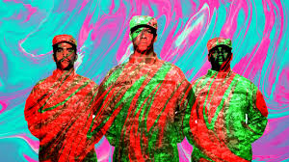
Concretely-Described Severe Interrogation (CDSI) methods
Threatening harm or death to family members of the individual as severe interrogation.
Cultural or religious humiliation as severe interrogation-i.e. deliberately making the individual endure things that might be commonplace in your own culture or religion but are deeply humiliating and psychologically agonizing in his/her culture.
Sensory deprivation or over- stimulation as severe interrogation-e.g. blocking or bombarding bodily senses to induce disorientation, psychosis and regression.
The use of psychotropic drugs or mind- altering substances (e.g. LSD) as severe interrogtion to induce disorientation, psychosis, or erasure of memory and identity.
Severe physical assault that leaves marks, bruises or lacerations, as severe interrogation.

Slide 47
Concretely-Described Severe Interrogation (CDSI) methods
Threatening harm or death to family members of the individual as severe interrogation.
Cultural or religious humiliation as severe interrogation-i.e. deliberately making the individual endure things that might be commonplace in your own culture or religion but are deeply humiliating and psychologically agonizing in his/her culture.
Sensory deprivation or over- stimulation as severe interrogation-e.g. blocking or bombarding bodily senses to induce disorientation, psychosis and regression.
The use of psychotropic drugs or mind- altering substances (e.g. LSD) as severe interrogtion to induce disorientation, psychosis, or erasure of memory and identity.
Severe physical assault that leaves marks, bruises or lacerations, as severe interrogation.

Slide 48
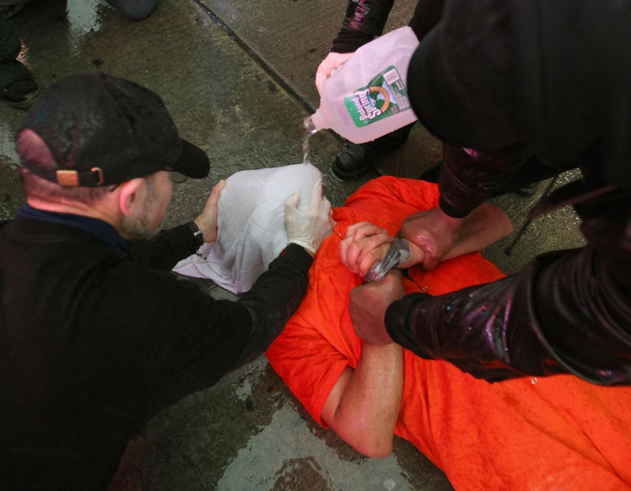
Concretely-Described Severe Interrogation (CDSI)
"Waterboarding" or any other form of stimulated drowning or suffocation as severe interrogation-e.g. making the individual undergo the physical and psychological experience of drowning to death.
Induced hypothermia as severe interrogation-e.g. exposing the individual to stimuli so cold that he or she develops hypothermia.
Electric shocks, especially to genitals and other sensitive areas, as severe interrogation.
Pulling out fingernails or toenails as severe interrogation.
Sexual humiliation as severe interrogation- e.g. forced nudity, making the individual do things that are sexually humiliating (in his or her cultural/religious tradition or in general).

Slide 49
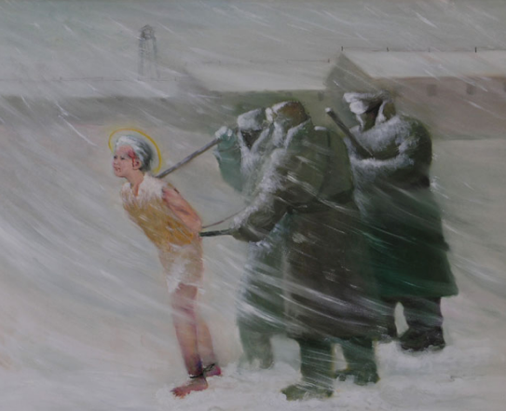
Concretely-Described Severe Interrogation (CDSI)
"Water boarding" or any other form of stimulated drowning or suffocation as severe interrogation-e.g. making the individual undergo the physical and psychological experience of drowning to death.
Induced hypothermia as severe interrogation-e.g. exposing the individual to stimuli so cold that he or she develops hypothermia.
Electric shocks, especially to genitals and other sensitive areas, as severe interrogation.
Pulling out fingernails or toenails as severe interrogation.
Sexual humiliation as severe interrogation- e.g. forced nudity, making the individual do things that are sexually humiliating (in his or her cultural/religious tradition or in general).

Slide 50
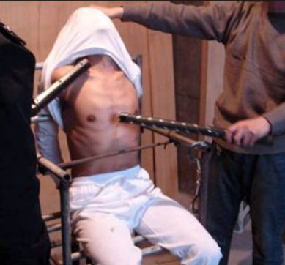
Concretely-Described Severe Interrogation (CDSI)
"Water boarding" or any other form of stimulated drowning or suffocation as severe interrogation-e.g. making the individual undergo the physical and psychological experience of drowning to death.
Induced hypothermia as severe interrogation-e.g. exposing the individual to stimuli so cold that he or she develops hypothermia.
Electric shocks, especially to genitals and other sensitive areas, as severe interrogation.
Pulling out fingernails or toenails as severe interrogation.
Sexual humiliation as severe interrogation- e.g. forced nudity, making the individual do things that are sexually humiliating (in his or her cultural/religious tradition or in general).

Slide 51
Concretely-Described Severe Interrogation (CDSI)
"Water boarding" or any other form of stimulated drowning or suffocation as severe interrogation-e.g. making the individual undergo the physical and psychological experience of drowning to death.
Induced hypothermia as severe interrogation-e.g. exposing the individual to stimuli so cold that he or she develops hypothermia.
Electric shocks, especially to genitals and other sensitive areas, as severe interrogation.
Pulling out fingernails or toenails as severe interrogation.
Sexual humiliation as severe interrogation- e.g. forced nudity, making the individual do things that are sexually humiliating (in his or her cultural/religious tradition or in general).

Slide 52
Concretely-Described Severe Interrogation (CDSI)
"Water boarding" or any other form of stimulated drowning or suffocation as severe interrogation-e.g. making the individual undergo the physical and psychological experience of drowning to death.
Induced hypothermia as severe interrogation-e.g. exposing the individual to stimuli so cold that he or she develops hypothermia.
Electric shocks, especially to genitals and other sensitive areas, as severe interrogation.
Pulling out fingernails or toenails as severe interrogation.
Sexual humiliation as severe interrogation- e.g. forced nudity, making the individual do things that are sexually humiliating (in his or her cultural/religious tradition or in general).

Slide 53
Study 1
199 York College students
Completed the questionnaire as part of the subject pool
Used all the measures just described

Slide 54
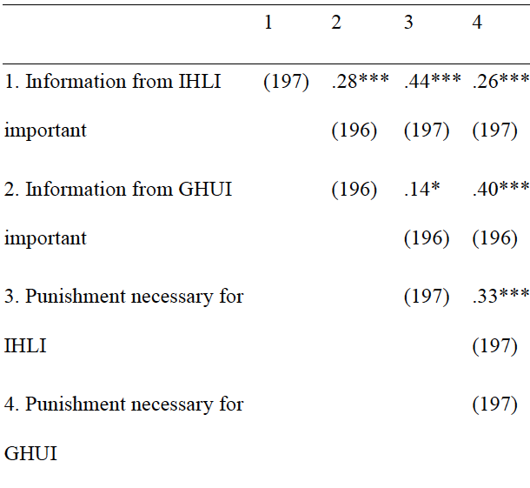
Even after reading the scenarios, participants still co-mingled their punitive and informational motivations.

Slide 55
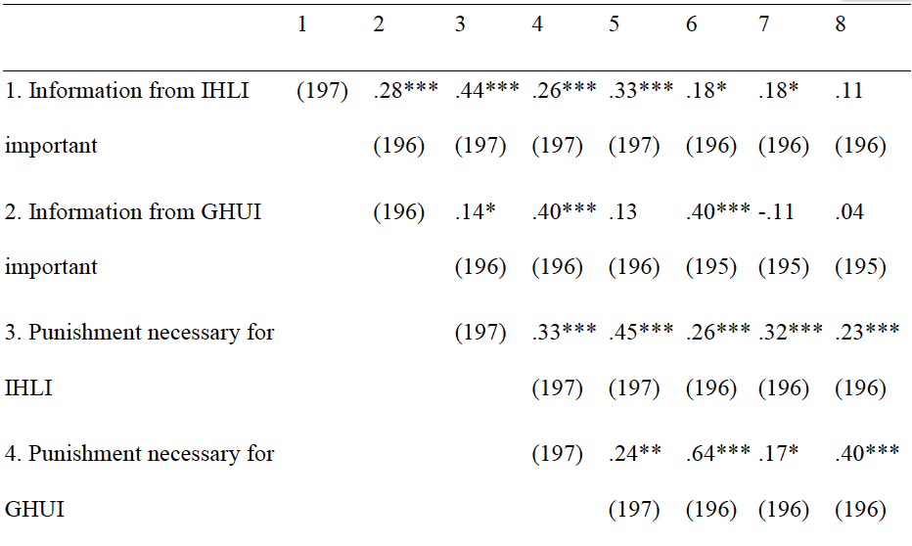
Participants also mixed both motivations with support for torture
ACSI (IHLI)
ACSI (GHUI)
CDSI (IHLI)
CDSI (GHUI)

Slide 56
But participants also differentiated in expected ways between detainees
Malik (IHLI detainee) considered more important to get information from than the Farid (GHUI detainee)
GHUI detainee considered more important to punish than the IHLI detainee
(Participants read the scenario correctly in other words)

Slide 57
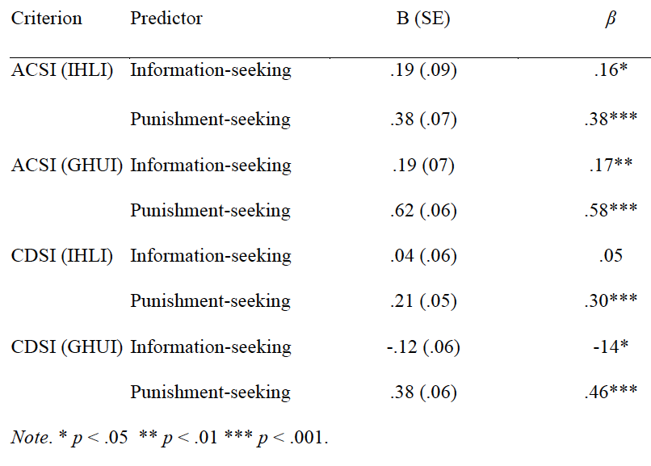
And punitive motivations overshadowed informational ones in predicting support for torture

Slide 58
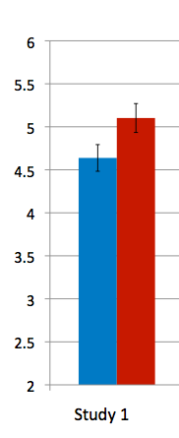
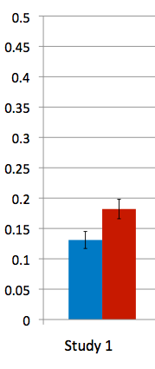
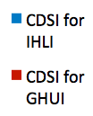
Main result
Participants recommended more torture for Farid (GHUI) than for Malik (IHLI)

Slide 59
Study 2
212 York College students
Like Study 1, but counterbalanced for order of which detainee participants read about first
Malik first, followed by Farid
or
Farid first, followed by Malik
Participants thus anchored their initial reactions to either Malik or Farid, and judged the second detainee relative to these initial reactions.

Slide 60
Results are largely the same
Regarding:
Overlap in judgments of punishment and informational importance for each detainee
Overlap of both judgments with support for torture
Torture support rooted more in rated importance of punishment than importance of information
More support for torturing Farid (GHUI) than Malik (IHLI)

Slide 61
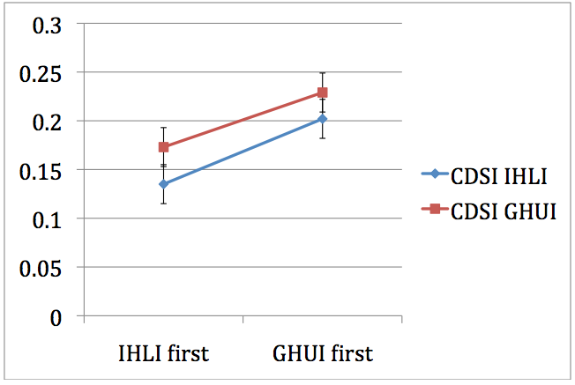
Special finding of Study 2
Reading first about innocent informed Malik (IHLI) substantially reduced participants’ inclination to torture EITHER detainee
Mean proportion of CDSI recommended for each detainee

Slide 62
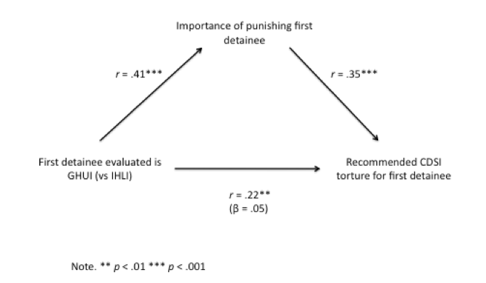
Punitive reactions help explain this effect
Part of the reason for this strong effect is that, when presented with Farid (GHUI) first, participants rated the need to punish the “first detainee” considerably higher compared to when that first detainee was Malik (IHLI)

Slide 63
Implication
Saliently reminding people that detainees can be informed but innocent may reduce popular inclinations to torture detainees

Slide 64
Study 3-no names
This is the one with two samples, one of 199 participants, one of 398 participants, both sets from York College
We greatly simplified the introduction of the detainees, simply describing them as:
Innocent but Highly Likely to be Informed (IHLI)
and
Guilty but Highly Unlikley to be Informed (GHUI)
We also left out measures assessing punitive and informational motivations

Slide 65
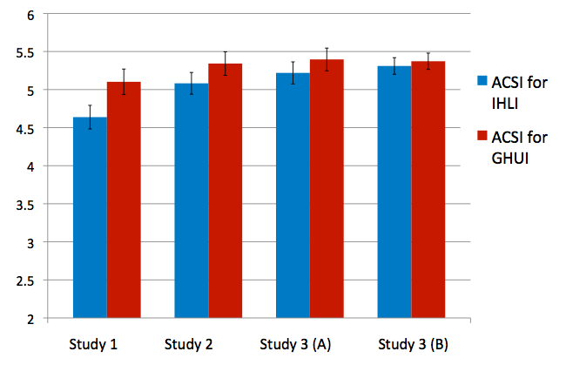
Findings (I)
Results largely the same (though weaker) for ACSI

Slide 66
Findings (II)
Results largely the same for CDSI

Slide 67
Summary
Participants would rather torture a probably “guilty” detainee probably not hiding information than a probably “innocent” detainee probably hiding information.
This preference is evident regardless of order in which detainees are presented
When controlling for punitive motivations, informational motivations have a negligible relationship with support for torture.
Anchoring participants’ impression of detainees with an innocent but informed detainee reduces support for torturing either detainee.
Scenario setting and names of detainees do not make a difference to this pattern of findings

Slide 68
Issues of relevance (I)
York College sample as a “recruitment vulnerable” sample, militarily speaking (ROTC on campus). York students might one day be ordered to torture by military brass.
The Joint Chiefs of Staff
The Commander-in-Chief

Slide 69
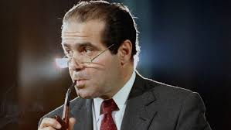
Issues of relevance (II)
Legal implications regarding the constitutionality of torture
One supreme court justice claimed the 8th amendment does not forbid interrogation torture since interrogations are for information from the legally innocent, not punishing the legally guilty
Scalia’s logic: interrogation torture doesn’t violate constitutional prohibition on cruel and unusual punishment because it’s not punishment
Antonin Scalia

Slide 70
But among those who are actually likely to administer torture at the grunt level (like those recruited into the armed forces by the ROTC)
The infliction of torture is motivated primarily by punitive concerns
Informational concerns barely register
To a large extent, this makes perfect sense, since torturing people is highly unlikely to elicit true information, but highly likely to be experienced by the tortured as punishment.

